Slide 1
Oh, the Humanity!
Kate Gregory
kate@gregcons.com
@gregcons
Notes:
I care a lot about the kind of code we write. Fast, yes. Correct, yes. But also readable, understandable, sensible, pleasant.
I’ve put a lot of work into looking at code and seeing how it could be better. Often making it better by using things we’ve added to C++ this century, or even this decade. Writing code that does the same thing but is clearer or shorter or more transparent or better encapsulated or whatever and looking at the before and after of that code.
In this talk, there’s some code. But it’s not really about the code. It’s about the people who write the code.
I want to start with the title

Slide 2
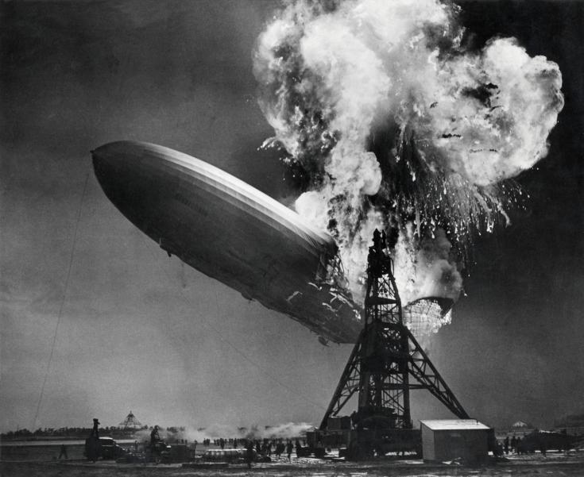
Notes:
By Sam Shere (1905–1982) - Zeppelin-ramp de Hindenburg / Hindenburg zeppelin disaster, Public Domain, https://commons.wikimedia.org/w/index.php?curid=19329337
This is a picture of the Hindenberg disaster in 1937, a zeppelin disaster. Herbert Morrison was recording the first recorded-on-the-spot radio news reporting. It wasn’t live to air, nor was he narrating over pictures. The sound and the pictures were put together in the years since. He was recording to disks that were driven back to the station to be played the next day, which in 1937 was a major big deal. And he had showed up basically to cover an iPhone launch, or a Tesla launch – certainly nothing as a scary as a SpaceX launch, some event where an amazing tech thing was happening and some very glamourous people were involved and it was all “we live in the future” and just marvelous. When suddenly this happened. Dozens of people died and he was upset by that, and having no training on how to stay calm while being recorded unexpectedly witnessing horrible deaths, he didn’t stay calm. He said it was terrible and the worst thing ever and yes, he said “oh, the humanity” while he was straining for words to paint his audience a picture of this terrible awful tragedy that he was obliged to tell them about. He actually stopped the recording a few times to allow him to regain his composure.

Slide 3
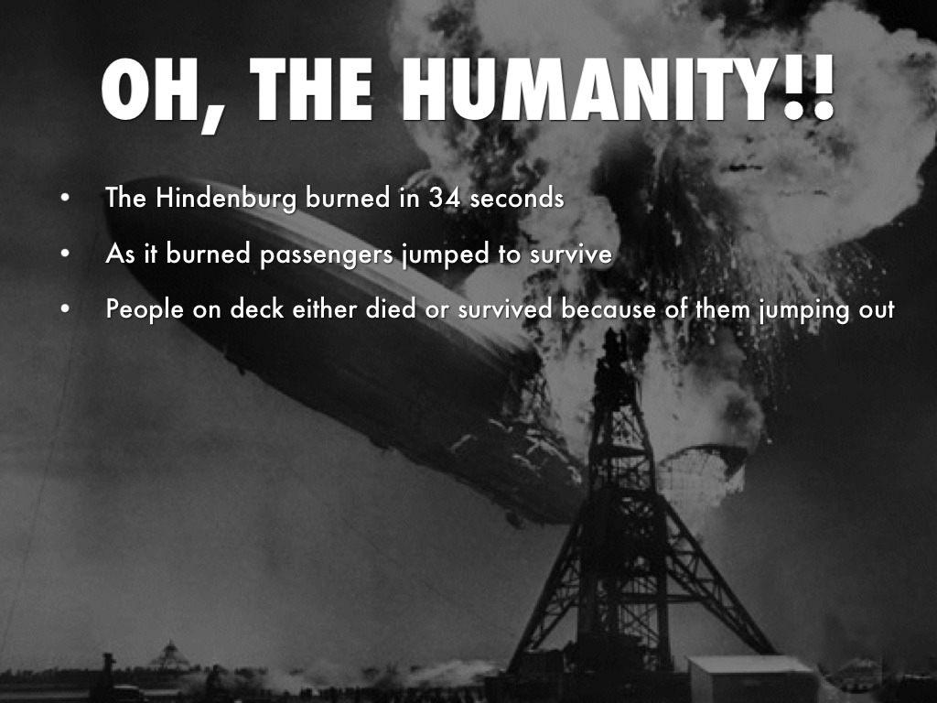
Notes:
Such an iconic image could be used in education material like this, from 2015
https://www.haikudeck.com/the-hindenburg-education-presentation-k66JfJSLQH
But it didn’t take long to get us to this:

Slide 4
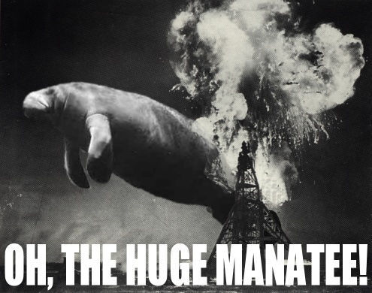
Notes:
https://knowyourmeme.com/memes/oh-the-huge-manatee
an idiom 'used in a satirical way to ridicule, diminish and trivialize emotional displays the speaker deems overly sentimental.'

Slide 5
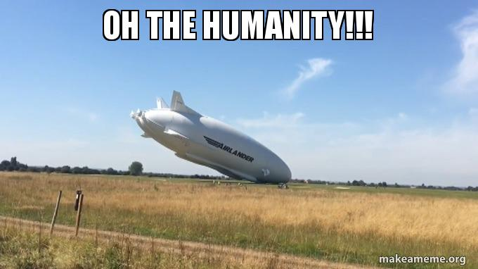
Notes:
And this.
So now whenever someone gets upset and starts to carry on, someone will take them down a peg and be sure to let them know that whatever they are complaining about doesn’t deserve that status. It isn’t a big enough problem for me to permit you emotions over it, my dude. Hey, did dozens of people die a painful fiery death at night in a thunderstorm when everyone thought it was a way cool high tech glamour event? Didn’t think so. Shut up.

Slide 6

No Emotions Allowed
Notes:
Now, what does this have to do with software development? And specifically with C++ software development, which is what I mostly do?
None of those disruptive out of band interrupts that emotions are. You must win arguments with logic and not with feeling strongly about things. Just the pure crystalline logic of the 1s and 0s of the matrix.
A lot of people really feel this way.
https://wallpapercave.com/w/t8mjzpV

Slide 7
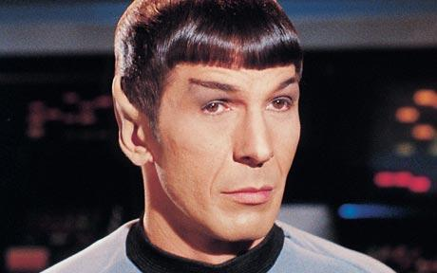
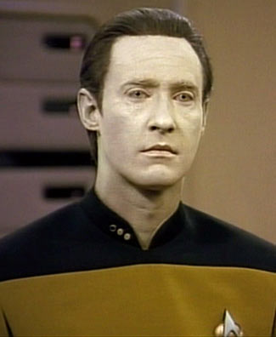
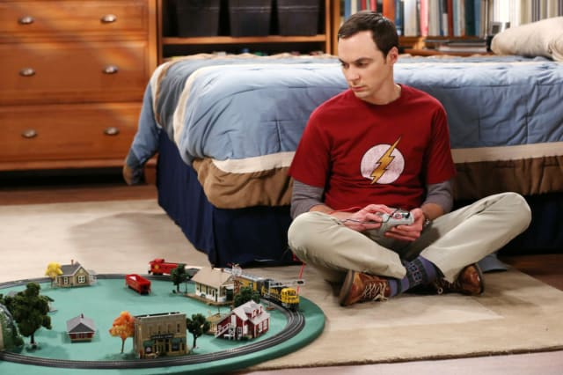
These are fictional characters
Not role models!
Notes:
Spock: http://whatchareading.com/live-long-prosper-peace-long-life/
Data: http://scifi.stackexchange.com/questions/15552/does-star-trek-tng-show-technology-discovered-by-kirks-generation
Sheldon: https://www.cbs.com/shows/big_bang_theory/news/1008904/which-sheldon-cooper-t-shirt-should-you-wear-/
A lot of us try to suppress emotions: in ourselves and in others. Mocking people for their “first world problems” or replying “oh the humanity” to them when they’re getting worked up is our way of enforcing a social norm within the programming community, especially programming communities that have roots in the 20th century rather than the 21st.

Slide 8
Stories We Tell Ourselves
Hard skills are worth more than soft skills
Emotions are for the weak
Code is just logical
I love getting away from people and back to simple pure code
Notes:
Hard skills are worth more than soft skills
Emotions are for the weak
Meetings are a total waste of time
Making software would be so much easier without these pesky users and their illogical demands
Everything is easier without emotions getting in the way
I love getting away from people and back to simple pure code
There’s no messy feelings when it comes to writing code
Code is just logical
Now, there is SO MUCH wrong in all this. We know that software development is a lot more than writing and debugging code, and that the not-code parts of it are FULL of emotion: getting users to tell you what they want instead of what they think they want, trusting your team, telling the truth about your limitations and dreams, being brave enough to go against the stream when you have to, keeping your integrity and values when you find yourself in a place that doesn’t share them, and much more. But I’m not here to talk about any of that today.
I want to focus in on just one myth, just one not-true thing that we all tell ourselves.

Slide 9
我们告诉我们自己
硬技能比软技能更有价值
弱者才需要情绪
代码只是逻辑
比起和人打交道我更喜欢编码
Notes:
Hard skills are worth more than soft skills
Emotions are for the weak
Meetings are a total waste of time
Making software would be so much easier without these pesky users and their illogical demands
Everything is easier without emotions getting in the way
I love getting away from people and back to simple pure code
There’s no messy feelings when it comes to writing code
Code is just logical
Now, there is SO MUCH wrong in all this. We know that software development is a lot more than writing and debugging code, and that the not-code parts of it are FULL of emotion: getting users to tell you what they want instead of what they think they want, trusting your team, telling the truth about your limitations and dreams, being brave enough to go against the stream when you have to, keeping your integrity and values when you find yourself in a place that doesn’t share them, and much more. But I’m not here to talk about any of that today.
I want to focus in on just one myth, just one not-true thing that we all tell ourselves.

Slide 10
There Are No Emotions In Code
There are
I can see them
Notes:
I have been paid to program since 1979, so that’s 40 years. And most of that time, I’ve been reading other people’s code, and my own old code. So you know what I say to that claim? LOL.
And that’s what I’m here to talk to you about today. There’s emotions in your code. Whether you like it or not, whether you know it or not, whether you meant to or not.

Slide 11
代码里没有情绪
有
我可以看到
Notes:
I have been paid to program since 1979, so that’s 40 years. And most of that time, I’ve been reading other people’s code, and my own old code. So you know what I say to that claim? LOL.
And that’s what I’m here to talk to you about today. There’s emotions in your code. Whether you like it or not, whether you know it or not, whether you meant to or not.

Slide 12
Here’s a Little Logic
Programmers are human beings
Human beings have emotions
Therefore…
Programmers have emotions
Emotions are not for the weak: emotions are for people
Notes:
propositional logic, not boolean
But surely these emotions don’t leak into our code? Oh sweeties, they really really do

Slide 13
简单的逻辑推理
程序员是人类
人类有情绪
因而…
程序员有情绪
不是弱者需要情绪,是人都需要
Notes:
propositional logic, not boolean
But surely these emotions don’t leak into our code? Oh sweeties, they really really do

Slide 14
Fear
//if (m_nCurrentX != g_nCurrentX
// || m_nCurrentABC != g_nCurrentABC) {
//}
Commented out code
I might not be doing this right; I might need this
Comments with who told you to change this
Don’t blame me if this does the wrong thing
Unused variables and code not removed
How can I be sure we won’t need it?
No time taken to clean up
I’m on a knife edge as it is, I can’t take time for that
Follow the same bad patterns that were there
I can’t stand up for doing it differently or better
// int nData; 3/22/03 uninitialized catch by VC7
int nData = 0;
int c,n;
int r1,r2,r3,r4;
double factor;
double pct1,pct2,pct3,v1,v2,v3,v4,v5;
double d1,d2,d3;
Notes:
The first example is a semi tricky “if” comparing the member variable values of things to some global values with similar names. That’s apparently no longer necessary, but the developer can’t bring themselves to throw it away. They aren’t sure they could get it back if they needed it again.
Second example from over 15 years ago is someone justifying why they’re initializing a variable. This is from live code still maintained today.
I’m including a few examples at first but not for everything – you’ve seen your share of this sort of code in the past, I’m sure.
One huge cause of fear, by the way, is crunch. Crunch makes everyone terrified that deadlines will be missed or projects will fail or teams will all be fired, and that makes people do everything the quick way even when they know it’s not how they should be doing it.

Slide 15
恐惧
注释掉代码
我可能不会这么做; 我以后可能会需要
在注释中说明谁告诉你要这样做
如果做错了请别责怪我(是别人让我这么做的)
没用的变量和代码没有移除
我怎么能够确定我们不需要它?
没有时间清理
我现在还有很多事情做,不能花时间在这个上面
遵循相同的坏模式
我不能忍受以不同或者更好的方式做到这一点
Notes:
The first example is a semi tricky “if” comparing the member variable values of things to some global values with similar names. That’s apparently no longer necessary, but the developer can’t bring themselves to throw it away. They aren’t sure they could get it back if they needed it again.
Second example from over 15 years ago is someone justifying why they’re initializing a variable. This is from live code still maintained today.
I’m including a few examples at first but not for everything – you’ve seen your share of this sort of code in the past, I’m sure.
One huge cause of fear, by the way, is crunch. Crunch makes everyone terrified that deadlines will be missed or projects will fail or teams will all be fired, and that makes people do everything the quick way even when they know it’s not how they should be doing it.

Slide 16
Fear
Checking what doesn’t need to be checked
I can’t be sure I’ll be looked after
Checking again and again
I can’t remember if I did or not, I can’t count on it
That was in a team-mate’s code, they might have changed it without telling me
Doing everything by hand
I need to see it, step through it
I can’t trust anyone else’s code
I’ve been hurt before
if (pPolicy) { delete pPolicy;}
Notes:
There’s so much fear in code I needed another slide
Deleting a null pointer is a no-op, it’s harmless, there is no need for this check but I see it all the time
And of course if you’re using delete, you’re probably doing it wrong.
Some of this fear is mitigated by tests. Writing code to see if your team-mates continue to keep their promises is not the most efficient approach

Slide 17
恐惧
检查那些不需要检查的(指针判空后delete)
我不确定不会有这样的场景出现
一次又一次地检查
我不记得我有没有做过检查,我不能指望已经检查过了
这是同事的代码,他们可能不通知我就改掉了代码
自己完成所有事情
我需要看到它,逐步完成它
我不能信任其它任何人的代码
我以前被坑过
Notes:
There’s so much fear in code I needed another slide
Deleting a null pointer is a no-op, it’s harmless, there is no need for this check but I see it all the time
And of course if you’re using delete, you’re probably doing it wrong.
Some of this fear is mitigated by tests. Writing code to see if your team-mates continue to keep their promises is not the most efficient approach

Slide 18
Arrogance
Tiny variable names
Aren’t you smart enough to figure out what these are?
Obscure function names
Why should I explain myself to people who can’t understand it without an explanation?
Deliberately opaque names
foo and bar considered harmful
f(), g(), etc not much better
Raw loops, own containers, own algorithms
In most cases
Perhaps “it ain’t bragging if you can do it” applies
Sneering comments and names
If you say lusers, pebcak, and rtfm in slack, you say it in your code too
void UndoStevesNonsense();
Notes:
Let’s talk about foo and bar for a minute. They come from fubar which comes from snafu. They are navy slang: snafu stands for Situation Normal, All Messed Up. It’s a form of dark humour among those facing death and realizing that the people above them don’t care a whole lot if their stuff is broken or missing or their orders are contradictory. Fubar stands for Messed Up Beyond All Recognition, and takes us beyond Situation Normal into a really dark place. Again, it is the talk of people who are literally facing death under very difficult circumstances. We are writing software, and while many of us are saving lives by doing so, we are not risking ours at the same time. And generally speaking the people above and around you do care if the stuff you have is broken, inadequate or in some other way, messed up. I object to foo and bar not because of the mild swearing – when I don’t have a mike on you’ll hear me swear from time to time – but because of the negative attitude. The miserable attitude. The whole “it doesn’t even matter” attitude. I don’t want to be that person, not even in a little piece of sample code. Because names do matter. They matter a whole lot. And choosing a name that means “ha ha names are stupid and so are you for wanting this thing to have one” is not reasonable.

Slide 19
傲慢
小的变量名(a,b,r之类的)
你笨到不能自己弄清楚这些是什么吗?
晦涩的函数名
为什么要向自己无法理解的人解释呢?
有意不清晰的命名
foo and bar considered harmful
f(), g(), etc not much better
原始循环,自己的容器,自己的算法
在大多数情况下
也适用于”不是跟你吹牛我能做到这一点”
冷嘲热讽的注释和命名
If you say lusers, pebcak, and rtfm in slack, you say it in your code too
Notes:
Let’s talk about foo and bar for a minute. They come from fubar which comes from snafu. They are navy slang: snafu stands for Situation Normal, All Messed Up. It’s a form of dark humour among those facing death and realizing that the people above them don’t care a whole lot if their stuff is broken or missing or their orders are contradictory. Fubar stands for Messed Up Beyond All Recognition, and takes us beyond Situation Normal into a really dark place. Again, it is the talk of people who are literally facing death under very difficult circumstances. We are writing software, and while many of us are saving lives by doing so, we are not risking ours at the same time. And generally speaking the people above and around you do care if the stuff you have is broken, inadequate or in some other way, messed up. I object to foo and bar not because of the mild swearing – when I don’t have a mike on you’ll hear me swear from time to time – but because of the negative attitude. The miserable attitude. The whole “it doesn’t even matter” attitude. I don’t want to be that person, not even in a little piece of sample code. Because names do matter. They matter a whole lot. And choosing a name that means “ha ha names are stupid and so are you for wanting this thing to have one” is not reasonable.

Slide 20
Selfishness
No time taken to clean up: refactor, rearrange, rename
Why should I spend my time making things easy for you?
Short and opaque names, magic numbers
I’m being measured here, and I’ve got tickets to close
Side effects and consequences everywhere
Public variables because it’s quicker
Mutable global state because it’s quicker
Information Hoarding
My job is safe if nobody else can do this
Notes:
Sees their coworkers as competitors
I don’t have to outrun the bear; I only have to outrun you

Slide 21
自私
没有时间清理:重构、重排、调整命名
为什么我要花费自己的时间来为你提供便利?
短小且含混不清的命名、魔数
在我这里已经正常工作了,不需要再调整/修改
影响到很多地方的副作用和后果
使用公共变量比较快
修改全局状态比较快
信息囤积
如果其他人不能完成这个我的工作就会比较安全(不容易被开除?)
Notes:
Sees their coworkers as competitors
I don’t have to outrun the bear; I only have to outrun you

Slide 22
Laziness
Whatever, it works
Mostly, enough anyway
No STL, no libraries to speak of
I can’t be learning new stuff, I have code to write
No testing, no build automation, no scripts
If you think that matters, you do it
Copy-paste-edit
Abstraction? Sounds like work to me!
No commitment to the future
Notes:
I mentioned crunch earlier. If you keep a team in crunch indefinitely, they will end up behaving in a way that is indistinguishable from laziness. They literally don’t have time to find out how to do things more quickly. They can’t invest an hour to save a day or a week. Nobody is letting them have the hour. They already aren’t sleeping enough and are keeping track of whose marriage has failed so far on a whiteboard in the common room. I can’t always be sure, when I read code like this, if it came from a lazy person among hard workers or from a crunch time among normal times; though the fact nobody goes back to fix it can be a clue.

Slide 23
懒惰
反正能工作,管它呢
在大多数情况下,实现到这程度就够了
不使用STL和其他库
我没时间学习新东西,我还有代码要写
没有测试、自动化构建、脚本
如果你认为这比较重要,你自己整
复制-黏贴-编辑
抽象?听起来好像对我有用!
对未来没有承诺
Notes:
I mentioned crunch earlier. If you keep a team in crunch indefinitely, they will end up behaving in a way that is indistinguishable from laziness. They literally don’t have time to find out how to do things more quickly. They can’t invest an hour to save a day or a week. Nobody is letting them have the hour. They already aren’t sleeping enough and are keeping track of whose marriage has failed so far on a whiteboard in the common room. I can’t always be sure, when I read code like this, if it came from a lazy person among hard workers or from a crunch time among normal times; though the fact nobody goes back to fix it can be a clue.

Slide 24
Code Shows Emotions
Fear
Arrogance
Selfishness
Laziness
Notes:
So is it true that code is only logic and has no emotions? Well, in some sense it is. You’re given a rule like “if today’s date is after the due date, then the item is overdue and this is how it gets processed.” There’s no emotion to that. But everything else, including the variable and function names you use, whether you make checking for overdue-ness a member function of something, what data type you use for dates and how you test “after”, all of that can and does carry emotion to someone who knows how to read it there.

Slide 25
代码展示了情绪
恐惧
傲慢
自私
懒惰
Notes:
So is it true that code is only logic and has no emotions? Well, in some sense it is. You’re given a rule like “if today’s date is after the due date, then the item is overdue and this is how it gets processed.” There’s no emotion to that. But everything else, including the variable and function names you use, whether you make checking for overdue-ness a member function of something, what data type you use for dates and how you test “after”, all of that can and does carry emotion to someone who knows how to read it there.

Slide 26
Why Does This Matter?
Empathy as you read and fix that legacy code
Does your team or workplace need to change?
A lodestar for yourself as you write new code or tidy old

Slide 27
为什么这很重要
在你阅读和调整遗留代码时你能够感受到
你的团队是否需要改变?
当你编码或者清理旧代码时,为你指明方向

Slide 28
But Can’t Some Code Be Neutral?
Shopping lists can be neutral
Love letters can’t
If they’re not actively warm and loving, they’re cold and disappointing
Letters of recommendation can’t
If they just confirm facts, they scream “bad hire”!
Code can’t either
No in between
And even if there was, why aim for that?

Slide 29
但是一些代码不能是中性的么
购物车可以是中性的
情书不能
If they’re not actively warm and loving, they’re cold and disappointing
推荐信不能
If they just confirm facts, they scream “bad hire”!
代码也不能
不能在两者之间
即使可以,为什么要这样t?

Slide 30
No Neutrality
Choose to Be
Instead Of
Confident and capable
Reassuring and obvious
Open and transparent
Humble
Generous and empathetic
Insecure and afraid
Secretive or slapdash
Information hoarding
Arrogant
Selfish
Notes:
Once you understand that everything you write is lighting up in one or the other of these columns, why not, when you can, take the time and put in the work to show what you stand for and to put yourself on the good side of these lists by putting your code on the good side of these lists?

Slide 31
不要选择中性
选择去
而不是
自信而且有能力
让人放心,显而易见
开放透明
谦卑
慷慨和善解人意
不安全感和害怕
Secretive or slapdash
信息囤积
傲慢
自私
Notes:
Once you understand that everything you write is lighting up in one or the other of these columns, why not, when you can, take the time and put in the work to show what you stand for and to put yourself on the good side of these lists by putting your code on the good side of these lists?

Slide 32
Look Where You Want to Go
Notes:
Like most Canadians, I’ve been taught how to drive on icy and slippery roads. You can take lessons where you practice going into a skid and recovering. But the best piece of advice for not hitting a tree or a truck or the guardrail or whatever is “look where you want to go”. If you lock your eyes on the thing the car is headed for, you will most likely watch it all the way until you hit it. Instead, look for an opening, a gap, something that’s not a thing to hit, and lock your eyes on that. Your hands and feet, reacting to the feedback from the car, will pretty much do the right thing and get you where you are staring. Your chances are way way better anyway. I’ve done this a few times and it really works.
And of course, it screams out to be taken metaphorically, doesn’t it? Focus on what you want in your code, not on what you don’t want your code to show about you.

Slide 33
Confidence
Delete things you don’t need
I have source control and work notes
Take time to clean up
It might help me, it might help someone else
Comments and names explain thinking
I know I’m right, let me show you
Obsolete or handrolled things replaced
I’m brave enough to stand up for doing things the right way

Slide 34
自信
删除你不需要的东西
我有源代码管理工具和工作记录
花时间去整理
可能对我有帮助,也可能会对其它人有帮助
用注释和命名解释你的想法
我知道我是对的,让我展示给你看
替换过时或者手动处理的东西
我有足够的勇气以正确的方式做事

Slide 35
Humility
Use libraries
Include a link to the doc if it’s not just cppreference.com
Gentle comments
Where things aren’t obvious, leave some help for the next person
Helpful names
For functions, variables, everything
I may not be the best, even though I’m very good
//Set page size to standard 8.5 x 11 (96 is DPI for WPF)
page->Height = 8.5 * 96;
page->Width = 11 * 96;
Notes:
Knowing you’re good is not the same as thinking you’re the best at everything.
The first version of this sample had the width before the height (it came from live code.) But the 8.5 x 11 is much easier to understand if you set them in that order.
I love reading humble code. Of course, humility is like zen: if you think you have it, you don’t!

Slide 36
谦逊
使用第三方库
如果无法在cppreference.com上找到,放置一个到文档的链接(非C++标准内容)
友善的注释
当事情不是那么明显是,为下一个人提供一些帮助
有帮助的命名
为函数、变量、所有的
尽管我很好,我可能不是最好的
Notes:
Knowing you’re good is not the same as thinking you’re the best at everything.
The first version of this sample had the width before the height (it came from live code.) But the 8.5 x 11 is much easier to understand if you set them in that order.
I love reading humble code. Of course, humility is like zen: if you think you have it, you don’t!

Slide 37
Generosity
Clean engineering to make next time easier
Well thought out encapsulation
Appropriate level of abstraction
Again, take time to clean up: refactor, rearrange, rename
Information sharing
My job is safe if we can all do this
Notes:
Then segue particularly to naming

Slide 38
慷慨
尽力去做使得下一次更简单
仔细考虑封装
适当的抽象级别
再说一次,花时间去整理: 重构, 重排,调整命名
信息共享
如果我们都能够做到,我的工作是安全的(?)
Notes:
Then segue particularly to naming

Slide 39
Let’s Talk About Names
Naming is hard
We’re famously bad at it
Why?
It requires empathy
Notes:
If you’re refactoring a hundred line block of code into a private member function, naming it is pretty easy. You know what it does so you call it that. Update. Ship. Release. Whatever. Things get harder if you’re naming a function in a public API, especially one that will be called by people who aren’t on your team and don’t use your words for things. And the more generic things get, the harder naming becomes, because you keep getting further from the person who’s going to consume the thing you’re naming, who’s going to consume your name.

Slide 40
让我们聊一聊命名
命名比较艰难
众所周知我们不擅长这个
为什么?
它需要共情(换位思考、感同身受)
Notes:
If you’re refactoring a hundred line block of code into a private member function, naming it is pretty easy. You know what it does so you call it that. Update. Ship. Release. Whatever. Things get harder if you’re naming a function in a public API, especially one that will be called by people who aren’t on your team and don’t use your words for things. And the more generic things get, the harder naming becomes, because you keep getting further from the person who’s going to consume the thing you’re naming, who’s going to consume your name.

Slide 41
An Algorithm Story
sort()
partial_sort()
partial_sort_copy()
top_n()
Notes:
When you are told this story: the implementor’s story, it all makes perfect sense. It’s logical, It’s intuitive. It’s obvious.
But put yourself in the shoes of the person who wants to find those best performers. They don’t think this way. That’s not the service they were looking for.

Slide 42
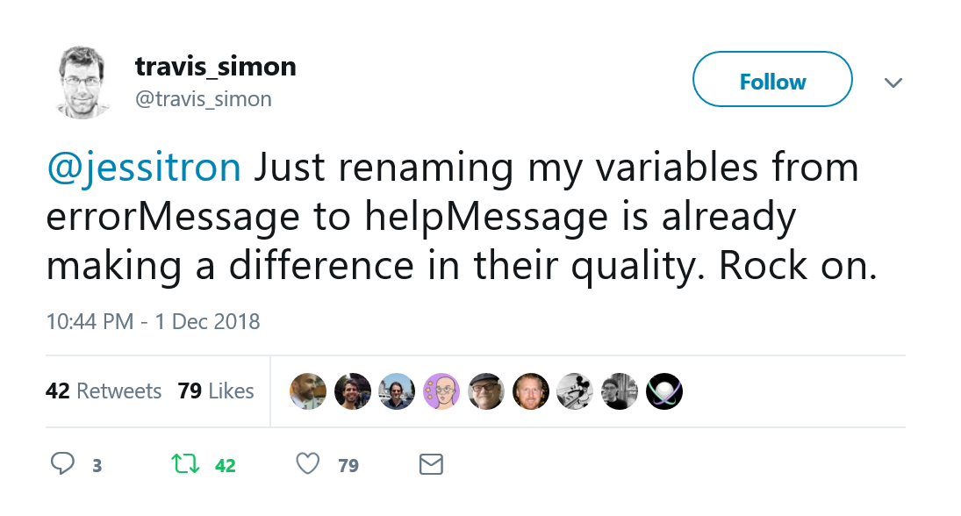
Notes:
This is about naming, and naming with empathy. An error message tells you what you did wrong. You’re wrong, you’re in error, you need to be corrected. A help message tells you what you need to do differently to succeed. It doesn’t carry a value judgement about what you did before. It might have been wrong. It might have been a perfectly valid attempt that sadly, the software can’t support. It might have been something people try to do all the time because the software makes it look like you can. Whatever. Let me help you carry on and move forward in doing your job. And while you might think, if I asked you whether it would change anything to rename errorMessage to helpMessage would anything change, nah, that couldn’t change anything, but Travis is telling you actually, it really did. It changed things.
You might be skeptical. But what’s the harm? Why not try a little empathy and see what improves?

Slide 43
Hard Working
It compiles, links, runs, and passes the tests
No warnings, no “you get one exception on startup, just hit Continue”, no stray files left behind
Tests are complete and well documented
I don’t have to be asked to do it right
It uses modern constructs or libraries or tools
I’m always learning; my code gets the benefit
But not tools for the sake of tools or for fun
Modern practices
Not just churning out code
Commitment to the future
My own ease
The team’s success
Notes:
This is the code of a hard working programmer who doesn’t do just the minimum to skate by. Who doesn’t just copy what was there before including the bad patterns and the bad code. Who takes the time to see if now is the time to change that thing that sort of grew organically and has become unwieldly and almost unmaintainable.

Slide 44
努力工作(?)
能够编译、链接、运行并通过测试
没有警告, no “you get one exception on startup, just hit Continue”, 没有遗留的文件(无用的内容)
测试比较完整,且有良好的文档
我不需要被要求以正确的方式去做(严格按照某个步骤才能工作)
使用现代设施、库、工具
我总是在学习; 我的代码从中得到了受益
但不是为了工具而使用工具
现代实践
不仅仅是制造代码
对未来的承诺
我自己很轻松
团队成功
Notes:
This is the code of a hard working programmer who doesn’t do just the minimum to skate by. Who doesn’t just copy what was there before including the bad patterns and the bad code. Who takes the time to see if now is the time to change that thing that sort of grew organically and has become unwieldly and almost unmaintainable.

Slide 45
Choose to Show Positive Emotions
Your code will be easier to read and maintain
You will enjoy reading and maintaining it more
Your reputation will improve
Even if the code isn’t better
But it probably will be
Notes:
So sure, your code could show fear, selfishness, laziness, and arrogance
But why not show confidence, generosity, humility, and how hard working you are?

Slide 46
选择展示正面情绪
你的代码会变得更易阅读和维护
你会更享受阅读和维护它
你的声誉会提高
即使代码不是更好
但是它可能会(更好)
Notes:
So sure, your code could show fear, selfishness, laziness, and arrogance
But why not show confidence, generosity, humility, and how hard working you are?

Slide 47
Call to action
Show your confidence
Clean up
Use a library
Make it right
Be generous and empathetic
Help users
Help your team
Name things well
You are going to show emotions in your code
They might as well be positive ones!
Notes:
… after all, we can’t avoid our own humanity. Thankyou.

Slide 48
采取行动!
展示你的自信
整理
使用库
做对事情
要慷慨和善解人意
帮助用户
帮助你的团队
把事情说好
你将在代码中显示情绪
他们可能也是正面的!
Notes:
… after all, we can’t avoid our own humanity. Thankyou.

